Slide 1
ABC COMPANY PRODUCTION DATABASE
RHYS HULBERT
SNHU IT 420

Slide 2
Log In
Users will log in using their server access credentials for authentication.
Users must be added to the program access table to have access to the program. Else, they will be denied.

Slide 3
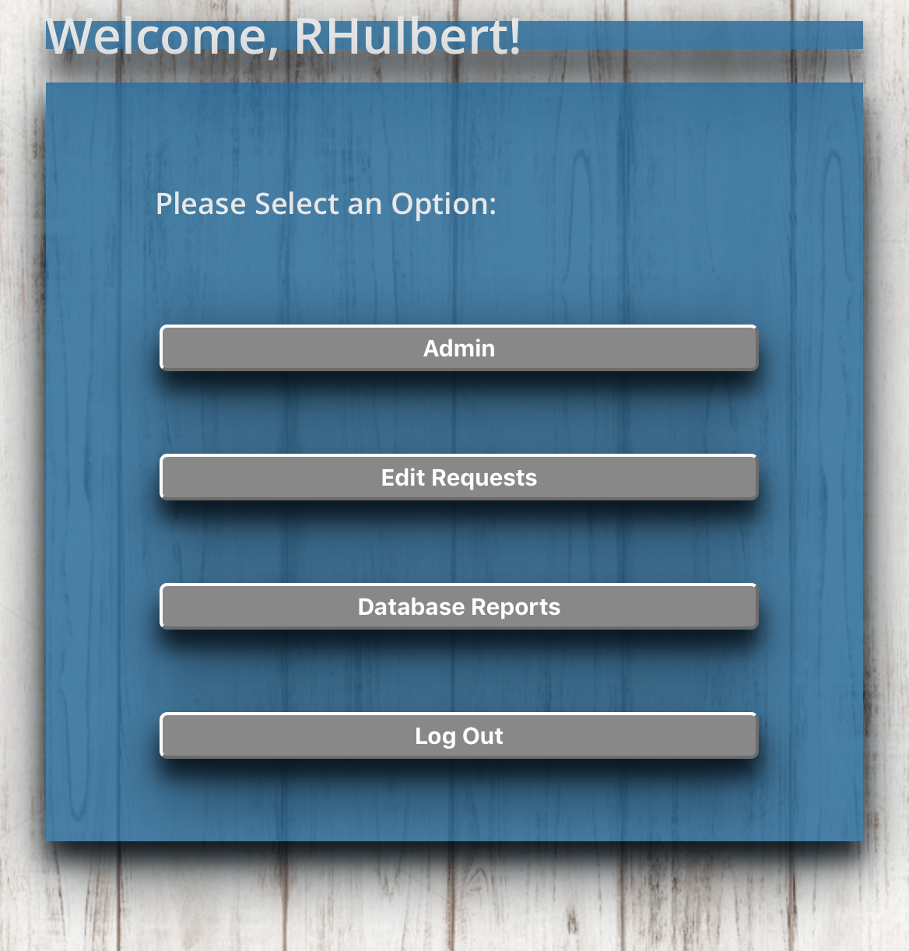
Manager Dashboard
Users with manager access will be routed to the manager portal; distinct from the user portal by blue coloring.
Managers will see their functions available on the main dashboard, “Admin”, “Edit Requests” and “Database Reports”.

Slide 4
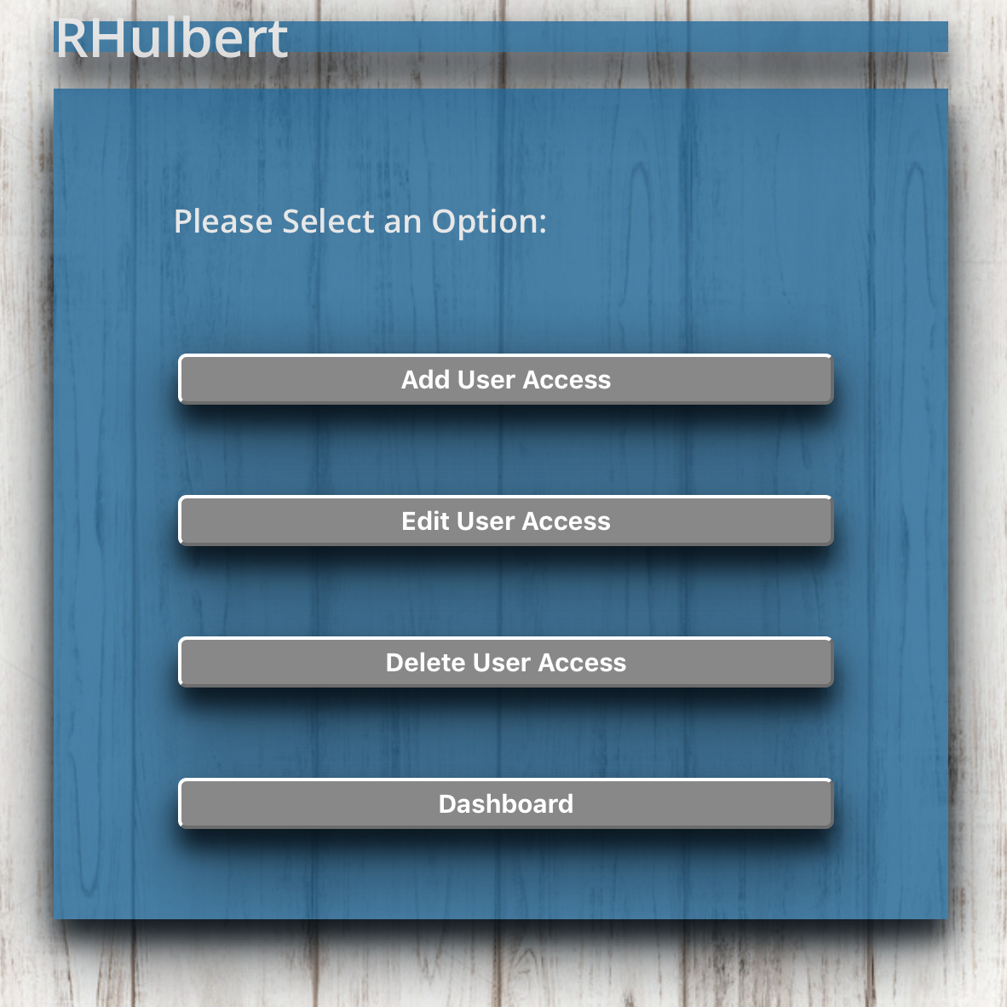
Admin Dashboard
This dashboard will provide managers with the capability of managing users for the program.
Users need both server access and user access for the program. Managers will ensure users are added for use.

Slide 5
Add User Function
Managers will be able to add users to the program access list.
Here they are prompted to set the user department, name, a username, and select the access that should be granted.
Note: Usernames must be unique or an error will display.

Slide 6
Edit User Function
Managers will be able to change settings for users such as name, username (must match server username) and access levels.
Managers do not have a data entry form for recording production.

Slide 7
Delete User Function
Managers will also be able to delete user access within the application.
Removing access directly from the application will allow an extra security measure for termination of employees as IT Security may take time to revoke server access.

Slide 8
Entry edit Review
Managers will select the item in the list to edit and approve, or simply delete from the request table to deny.
This is a manual form and managers will duplicate what is displayed in the drop down into the form which has the correct information. It replaces the row in the completedTask table.
Unfortunately, once approved, managers will need to manually delete entry until a fix is applied to auto-delete.
Managers will have the ability to review edit requests sent by users to review and approve or deny.
In the back end, users that request the edits will be inserting a row for editing into a table mEditList with a column designed specifically for use in the drop down display.
The displayed results from an array string which shows the correct data to be entered.

Slide 9
Data Review
Managers will be able to see a table of all of the data entered into the completedTask table.
This display does not limit the amount of rows that can be displayed or narrow the data to a set day range.
Managers at ABC Company can alternatively use the company query software to retrieve this data and customize the parameters.

Slide 10
Log In
Users will log in using their server access credentials for authentication.
Users must be added to the program access table to have access to the program. Else, they will be denied.

Slide 11
User Portal
Users will have their own portal to perform the functions they need.
The user portal will be identified by red coloring to separate from the manager portal.
The distinction between the two occurs in the programming to test admin access level and directs the user to the accurate portal without a separate login screen.

Slide 12
User Portal Continued
The user portal will allow the user to perform three functions.
Task form, edit request form and review form for all entered data.

Slide 13
Task entry form
This form is the main user function which is to enter all production data into the database for manager review.
This form allows users to select each element and enter in the date of completion of each task and submit.

Slide 14
Edit request form
Users will be able to select up to two separate reasons for the changes that need to be made.
This will display for managers to see why the changes are made and avoid users wasting time sending emails for managers to have another step in the process.
Users had requested a means of editing entered data or a way to request the edits. This form allows users to select the row in the database that needs editing.
The user fills the form with the correct data to submit to managers for approval or rejection of the changes.

Slide 15
User Entry review
Users will also have a feature that allows them to see all of the data they have entered into the database.
The list sorts from mot recent to oldest in the list, making it easy to review entries for missing items, duplicates, errors, etc.

Slide 16
Future enhancement possibilities
Manager portal
User Portal
Combining all options into one dashboard or all manager pages into one page using tabs.
Auto-delete from mEditList on edit approvals.
Change the data review page to a data dashboard that shows quick overview numbers for current week/month.
Combined task entry page with data review list or a form that adds to a list and a submit form that will submit whole list at once.
Delete request form to delete duplicates, etc.
Limited self-edit options such as date changes or count changes which will show up in a user edit report for managers.

Slide 17
Future enhancement possibilities Continued
GUI
Programming
Single page application rather than multiple pages.
Custom functions per user – manager access with task entry form.
Static navigation bar to jump between screens and replace dashboard.
IT Ticket feature to report issues.
AngularJS, Java, JavaScript languages.
Switch cases to combine functions into fewer files.
Injection prevention coding.
Redesigned code to minimize inline programming in the GUI files.

